Slide 1












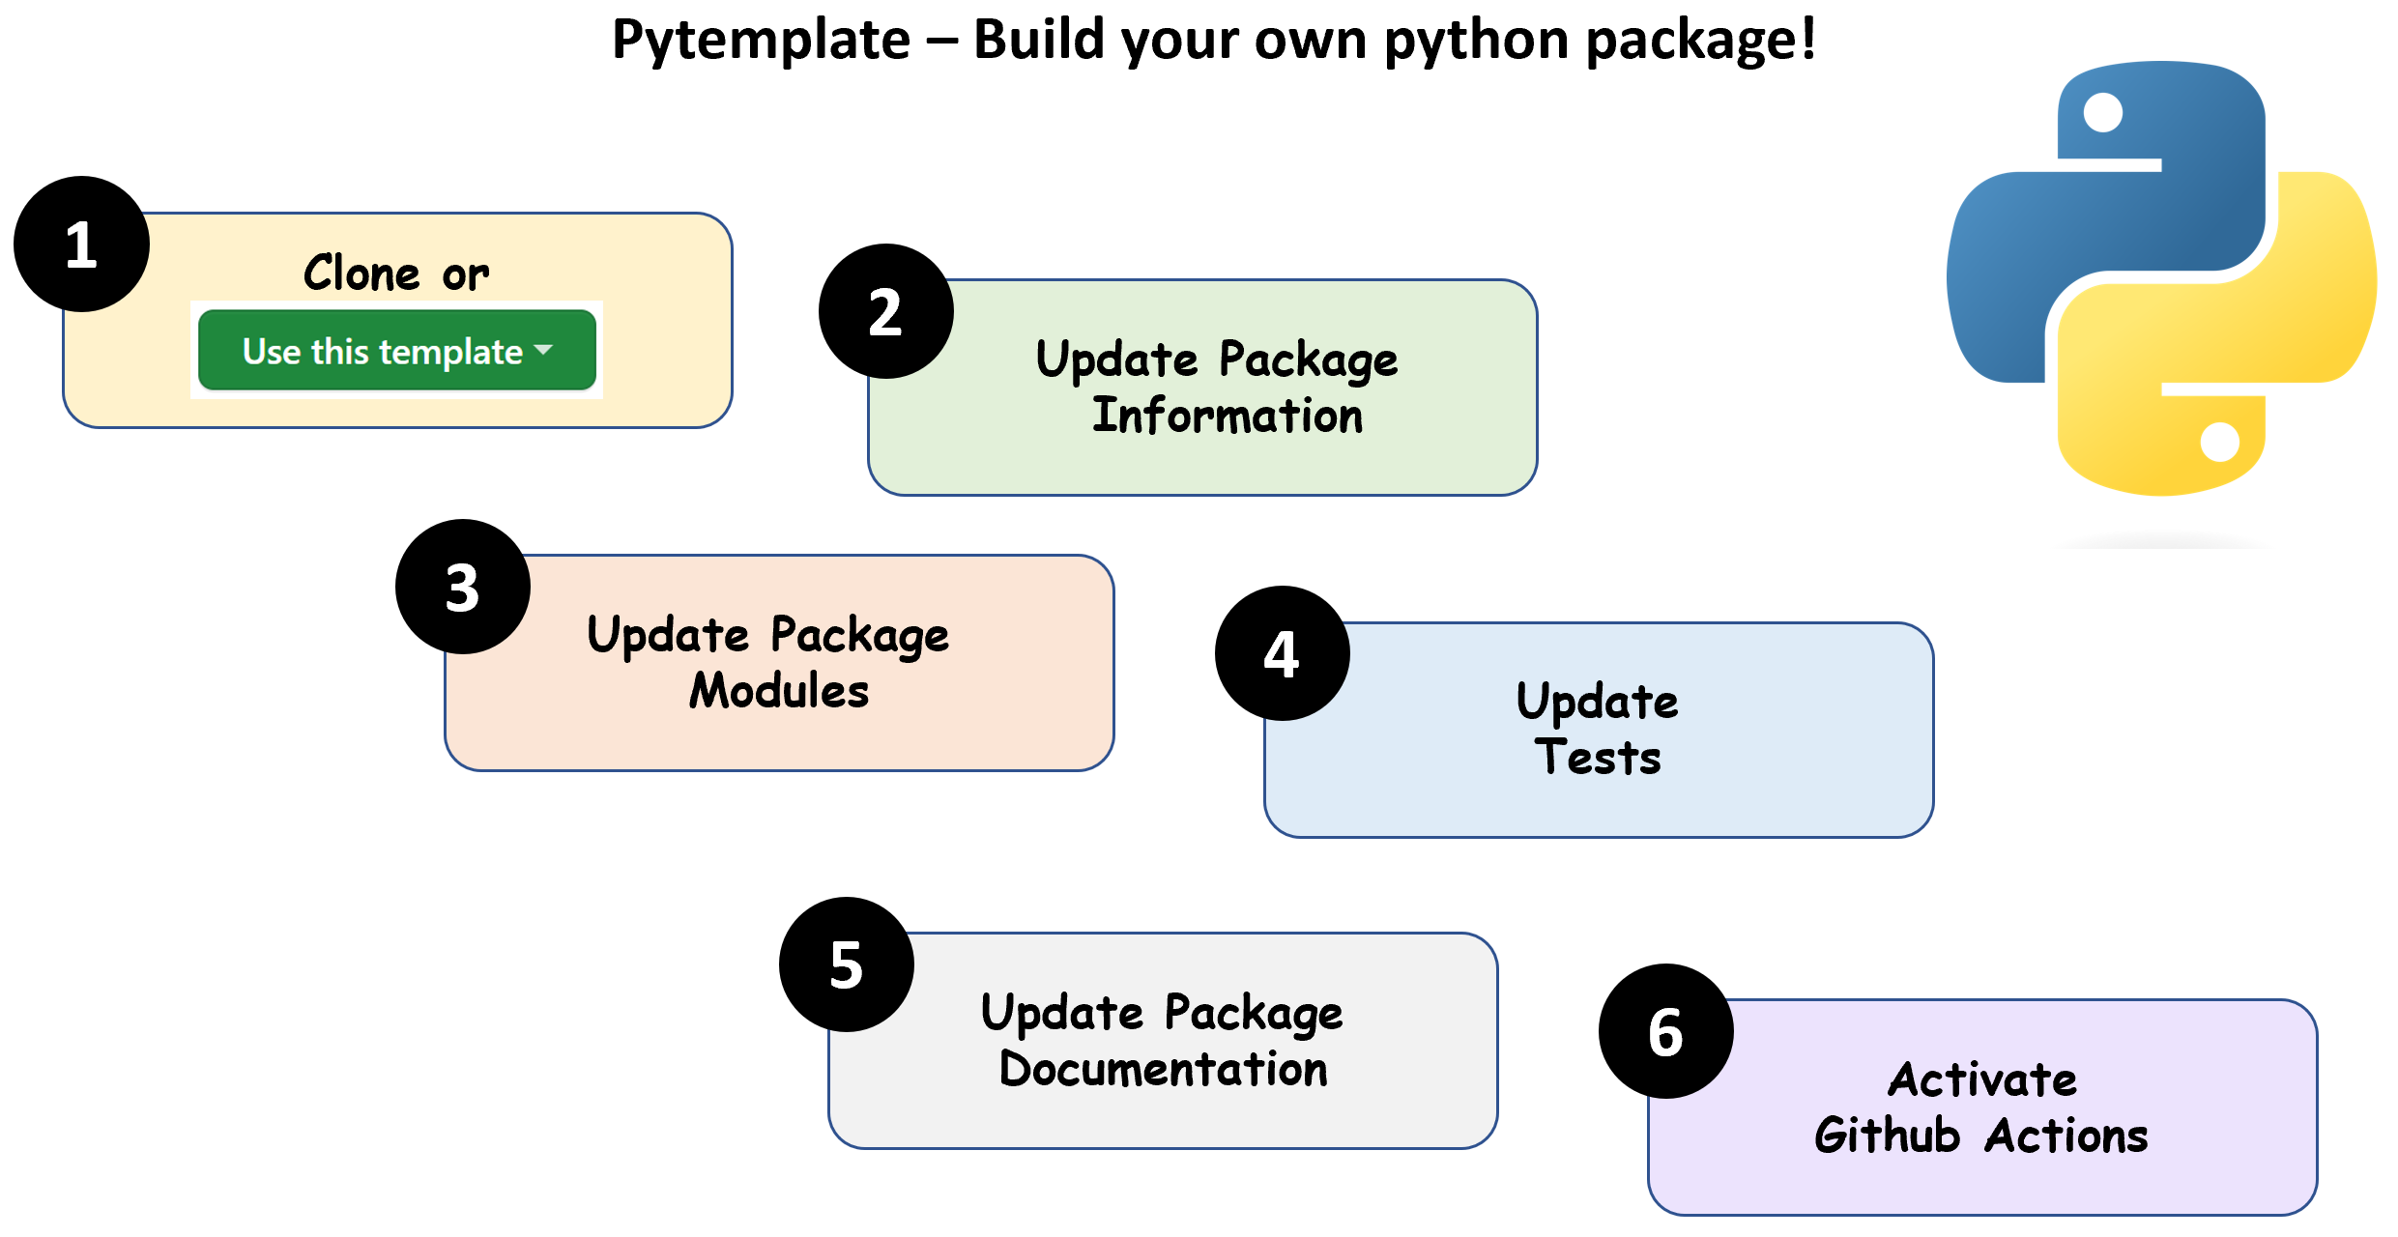
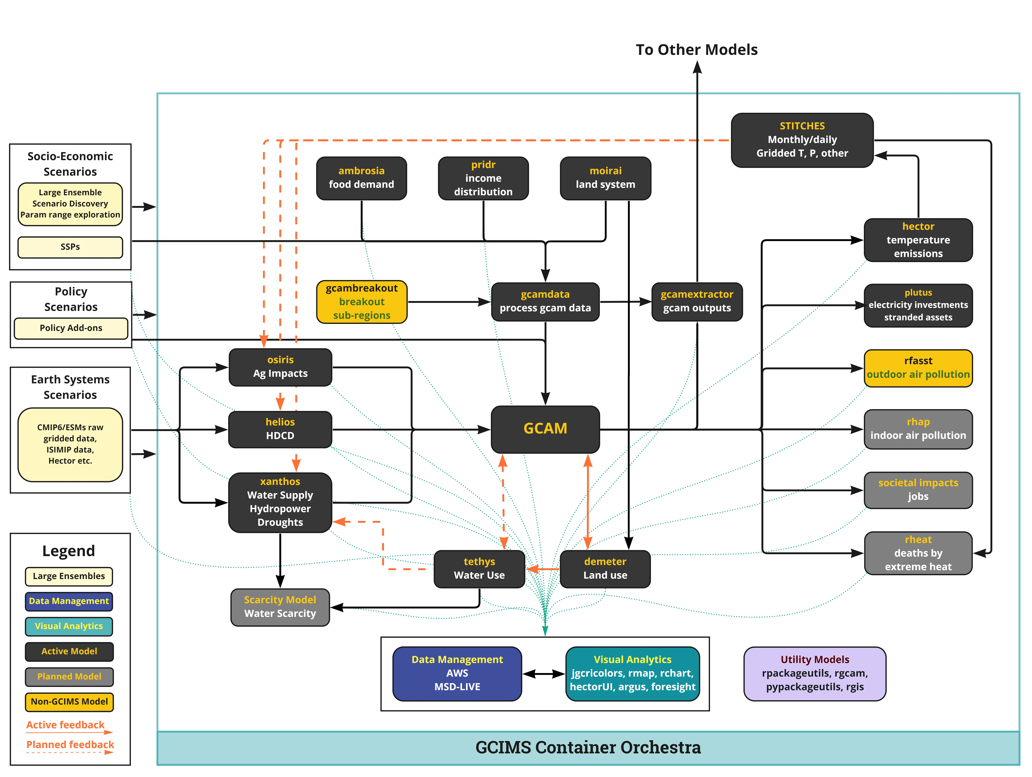
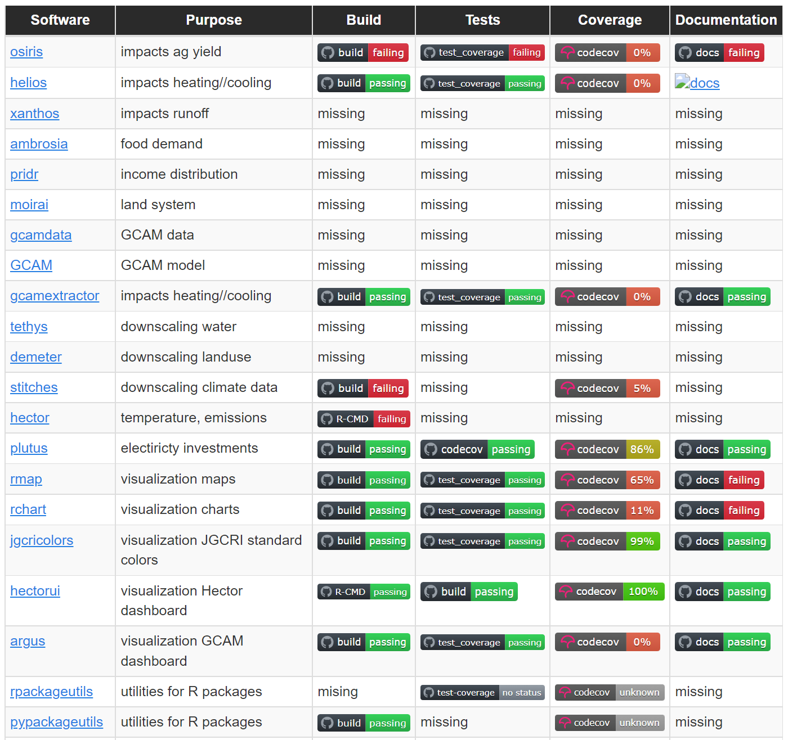
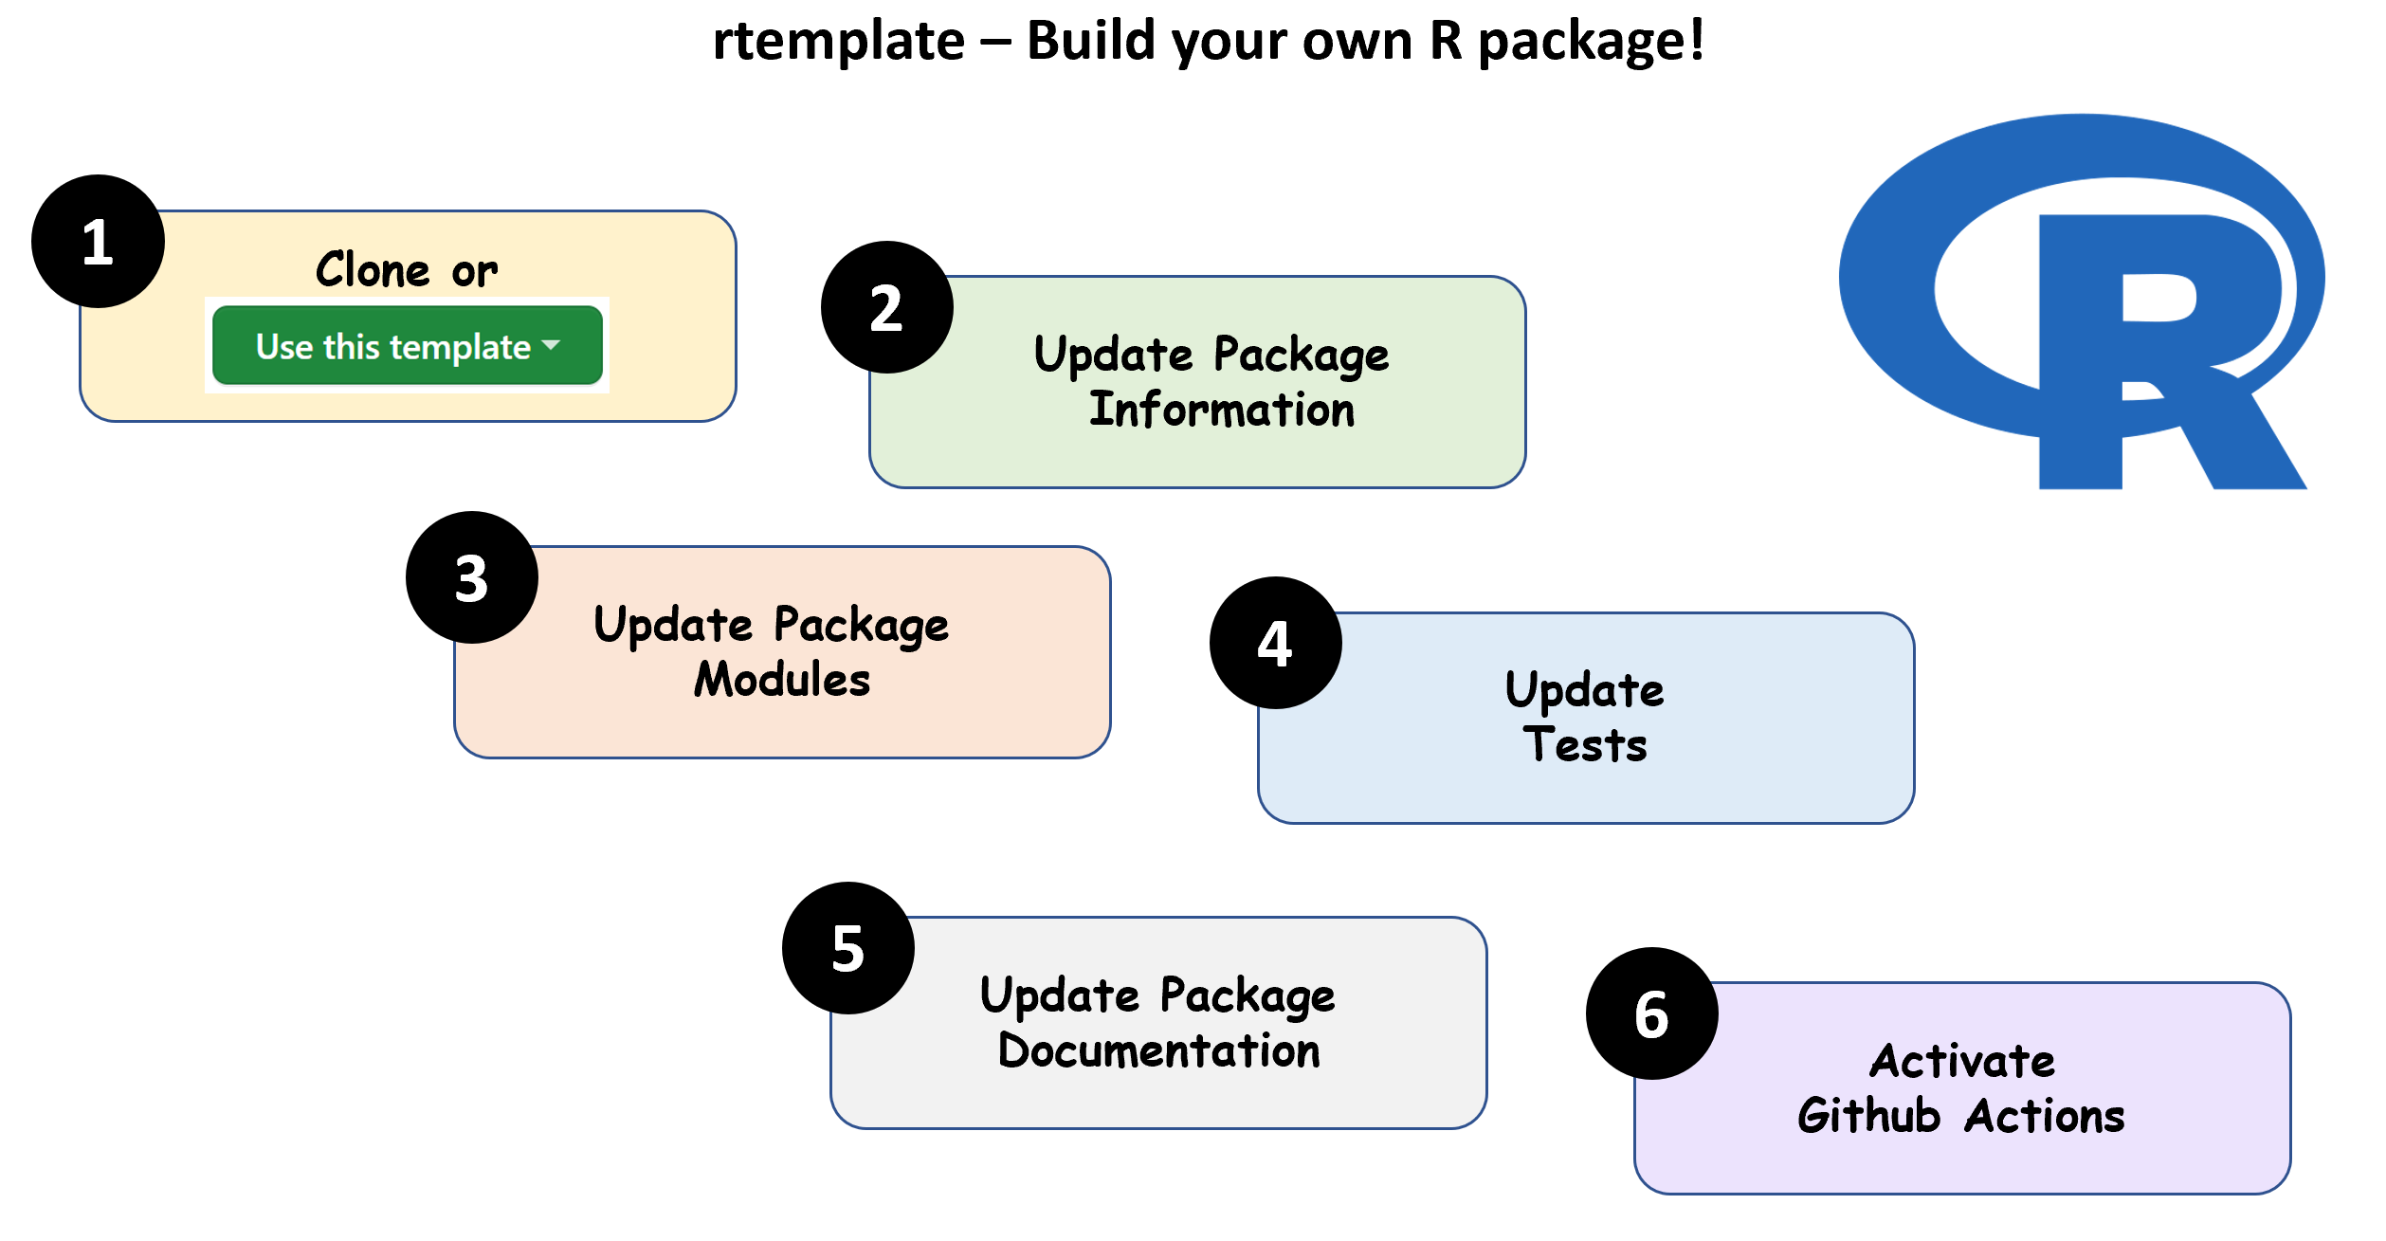




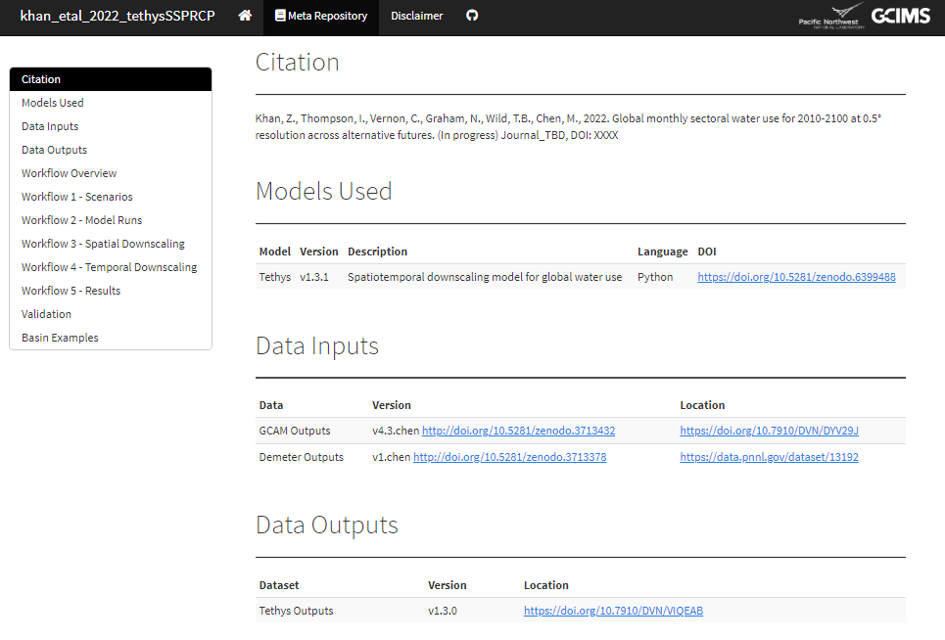
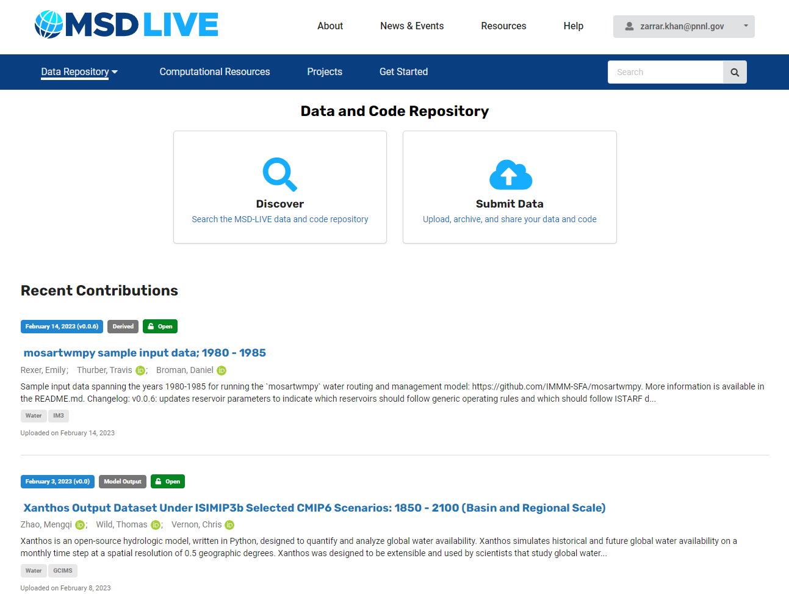
GCIMS - Integration: Reproducible, robust, and scalable workflows for interoperable human-Earth system modeling
Zarrar Khan*, Chris Vernon, Pralit Patel, Isaac Thompson, Benjamin Knight *zarrar.khan@pnl.gov
Motivation
Data
1
Scripts
Publications
Issue | Solution
Stranded Scripts | Pakcaged Models
Stranded Knowledge | Software Map Documentation
Stranded Model Versions | Software Health CI/CD
Stranded Analysis | Reproducible Workflows
Stranded Datasets | Data Management Miniting DOIs
Stranded Insights | Dashboard Persistent Insights
4
1
GCAM
v X.X
Analysis
2
Outputs
5
3
3
4
Models
6
5
2
Teams
Insights
6
1
2
3
Packaged Models
Software Map
Software Health
Clear Templates for R & Python Packages
Software Map
Overall System Health Monitoring
https://jgcri.github.io/gcims_integration/#/models
Package Design
https://jgcri.github.io/gcims_integration/#/map
https://jgcri.github.io/gcims_integration/#/health
Overall System Monitoring
Folder Structure
Continuous Integration
Multi OS Build Checks
Code Testing
Documentation
Track down and Map out
Continuous Integration
Multi OS Build Checks
Code Testing
Code Coverage
Documentation
Data sources
Existing models
Planned models
Inter-linkages
Reproducible
Workflows
4
5
6
Data Management
Persistent Insights
Persistent Data Management
Reproducible Workflows
https://data.msdlive.org/
https://jgcri.github.io/gcims_integration/#/workflow
https://jgcri.github.io/khan-etal_2022_tethysSSPRCP/metarepo.html
FAIR
Findability
Accessibility
Interoperability
Reusability
Key Features
Minted with DOIs
Meta-data
Storage (MSD, Deception, Cloud)
Meta-repo templates
Inputs with DOI
Outputs with DOI
Workflows
Validation
Results
Containerization
Scalable
Cloud/On-prem/hybrid
Curated Insights
Persisting key figures across existing & future research
Persisting key analysis across existing & future research
Accesibility and reusability for a broad audience
11/9/2023
| PNNL-SA-XXXXX

